Slide 1
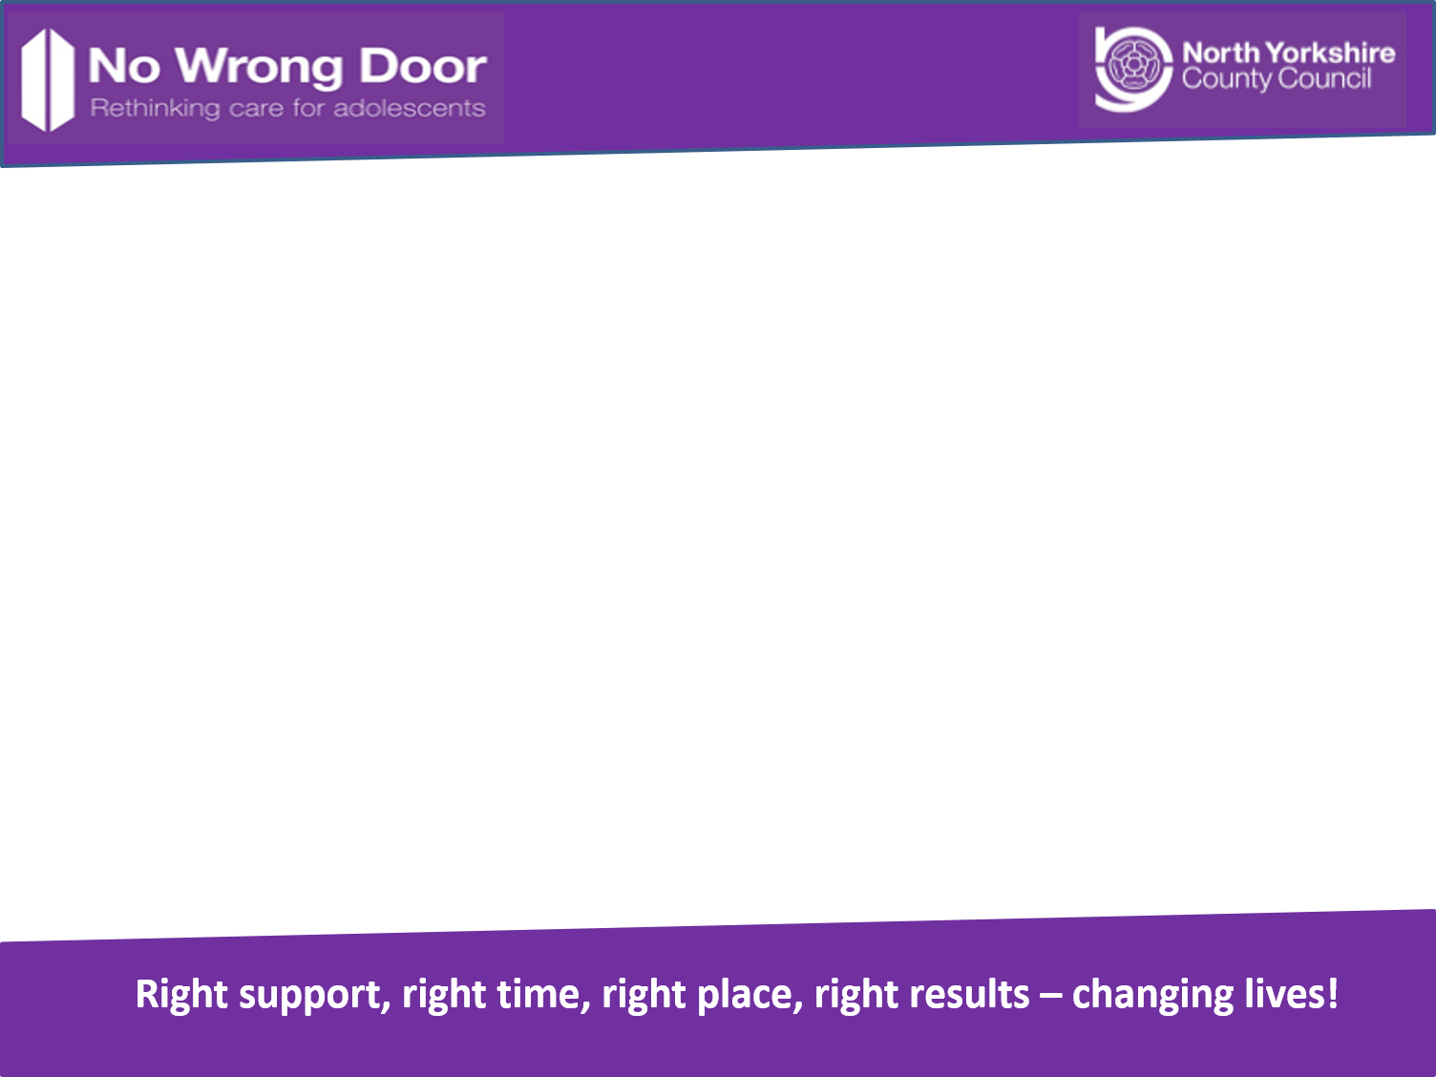
Practical use of the LAC Cost Calculator
Presented by:
David Gillson
(NWD Performance and Intelligence Officer)

Slide 2

Costed Case Study
16 year old male
Numerous placement breakdowns until Autumn 2013
First referral in 2011
Considered “unfosterable”
Placed into Long Term Local Authority Residential care Autumn 2013

Slide 3
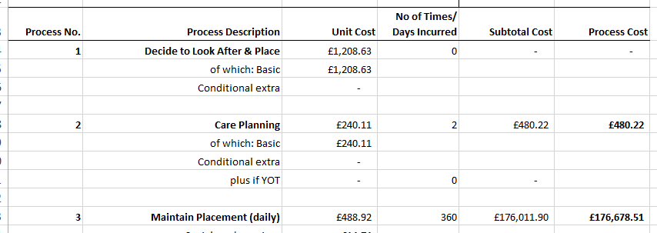
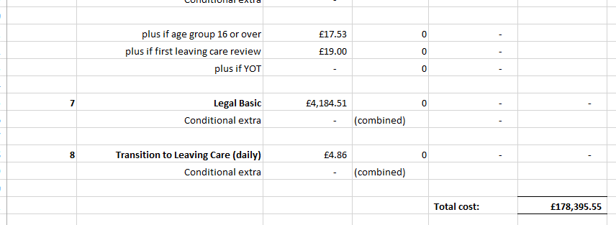
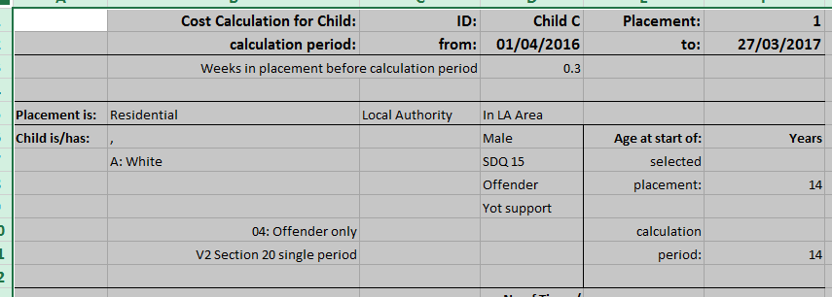
Cost to NYCC
Year One

Slide 5
Child C in Foster Care
Child C was successfully placed in foster care. The foster family was one of the key workers at a NWD hub who worked with Child C
Child C built up a very strong relationship with this worker.
Child C had been in this placement for the same period he was in residential care
In addition, since going into foster care, Child C’s involvement in criminality, arrests, charges, and missing from home incidents have decreased to none.

Slide 6
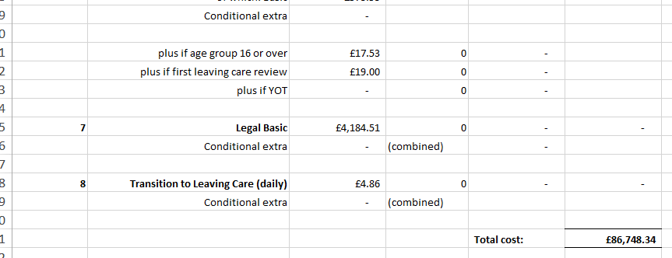
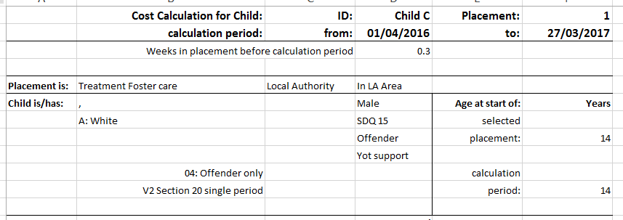
Cost to NYCC Year 2

Slide 8
Summary
Year One in residential placement cost NYCC an estimated £178K
Year Two in specialist foster care cost an estimated £86K
This is a 51% saving to NYCC
Plus
Much better outcomes for Child C

